Slide 1
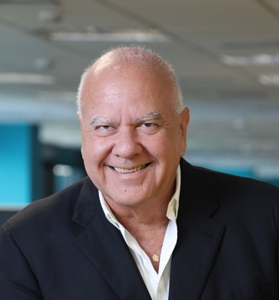
5th PPSA Oil Tender
June 26, 2025 - at B3 São Paulo Stock Exchange
OTC Houston 2025
Samir Passos Awad
Finance, Admin & Marketing Director

Slide 2
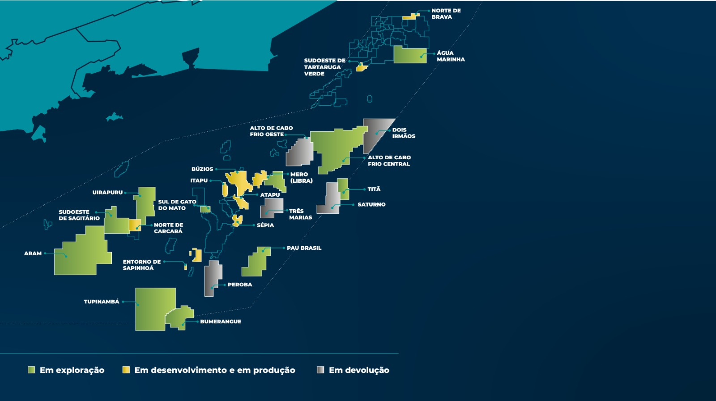
PRE-SALT POLYGON
On exploration
In development and/or production
Abandonment

Slide 3
PPSA Oil Trading History (MMbbl)
Auction | Field | Lot | Period (months) | Volume (MM bbl) | Total Volume (MM bbl)
1st & 2nd | Mero | Lot 1 | 36 | 10.60 | 12.30
 | Tupi | Lot 2 | 12 | 1.10
 | Sapinhoá | Lot 3 | 36 | 0.60
3rd | Búzios | Lot 1 | 36 | 6.60 | 55.70
 | Sapinhoá | Lot 2 | 60 | 2.40
 | Tupi | Lot 3 | 60 | 3.30
 | Mero | Lot 4 | 36 | 43.40
4th | — | Lot 1 | 12 | 12.08 | 37.72
 | Mero | Lot 2 | 12 | 12.08
 | — | Lot 3 | 12 | 11.07
 | Búzios | Lot 4 | 12 | 2.50

Slide 4
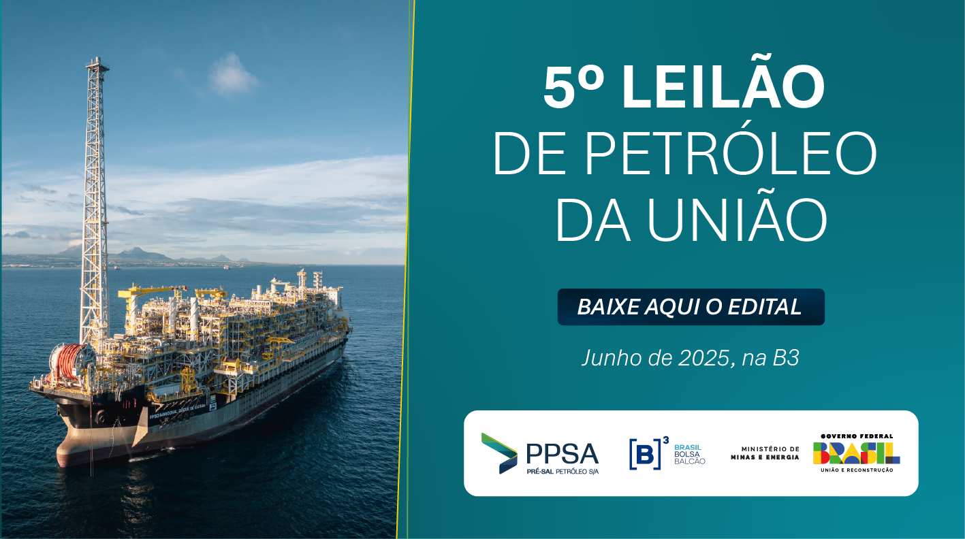


Slide 5
5th PPSA Oil Tender
June 26, 2025 - at B3 São Paulo
LOT | LOT OIL/FPSO | Volume to be loaded in 2025 (thousand barrels) | Volume to be loaded between 2026 and Feb/27 (thousand barrels) | Total volume in (thousand barrels) 7 | Final loading programs issued in | Loading in
1 | Mero/Guanabara¹ |  | 14.000 | 14.000 | Jan a Dec/26 | Mar/26 a Fev/27
2 | Mero/Sepetiba¹ |  | 14.000 | 14.000 | Jan a Dec/26 | Mar/26 a Fev/27
3 | Mero D. de Caxias¹ |  | 14.000 | 14.000 | Jan a Dec/26 | Mar/26 a Fev/27
4 | Mero/Alex. Gusmão² and Mero/FR³ | 1.500 | 13.500 | 15.000 | Jul/25 a Dec/26 | Sep/25 a Fev/27
 |  |  | 2.500 | 2.500 | Jan a Dec/26 | Feb/26 a Fev/27
5 | Búzios³ |  | 3.500 | 3.500 | Jan a Dec/26 | Mar/26 a Fev/27
6 | Itapu⁴ | 1.500 | 5.000 | 6.500 | Jul/25 a Dec/26 | Sep/25 a Fev/27
7 | Sépia⁵ | 3.000 | 2.000 | 5.000 | Jul/25 a Dec/26 | Sep/25 a Fev/27
8 | Bacalhau⁶ | 1.000 | 3.000 | 4.000 | Jul/25 a Mar/26 | Sep/25 a May/26
 | TOTAL | 7.000 | 71.500 | 78.500

Slide 6


5th PPSA Oil Tender
Remarks about sales volumes
¹ Mostly one million barrel shipments.
² First four Alexandre de Gusmão FPSO sales will be 500,000 barrel each, rising to one million after ramping up.
³ 500,000 barrel shipments.
⁴ In general, 500,000 barrels shipment
⁵ 500,000 barrel shipments, eventually rising to one million barrel.
⁶ Bacalhau one million barrel shipments.
7 PPSA best estimates at the moment, being subject to changes.

Slide 7
5th PPSA Oil Tender – Eligible Participants
Individual Bidders
(Brazilian companies only):
Joint Bidders
(Up to 3 companies):
Consortia
(Up to 3 companies):
Clique aqui pra inserir o texto Clique aqui pra inserir o texto
Clique aqui pra inserir o texto Clique aqui pra inserir o texto Clique aqui pra inserir o texto
Clique aqui pra inserir o texto Clique aqui pra inserir o texto
Clique aqui pra inserir o texto Clique aqui pra inserir o texto Clique aqui pra inserir o texto
E&P companies
Oil refining companies
Oil trading companies that are part of an Economic Group with:
- An E&P company, or
- A refinery
Must include at least one company as listed (left)
Maximum of two E&P companies
Brazilian or Foreign Members may include:
1. E&P companies
2. Refining companies
3. Oil trading companies linked to:
– An E&P company, or
– A refinery
4. Logistics companies
Must include at least one Brazilian company as listed (left)
Maximum of two E&P companies
Foreign companies may not be leaders

Slide 8
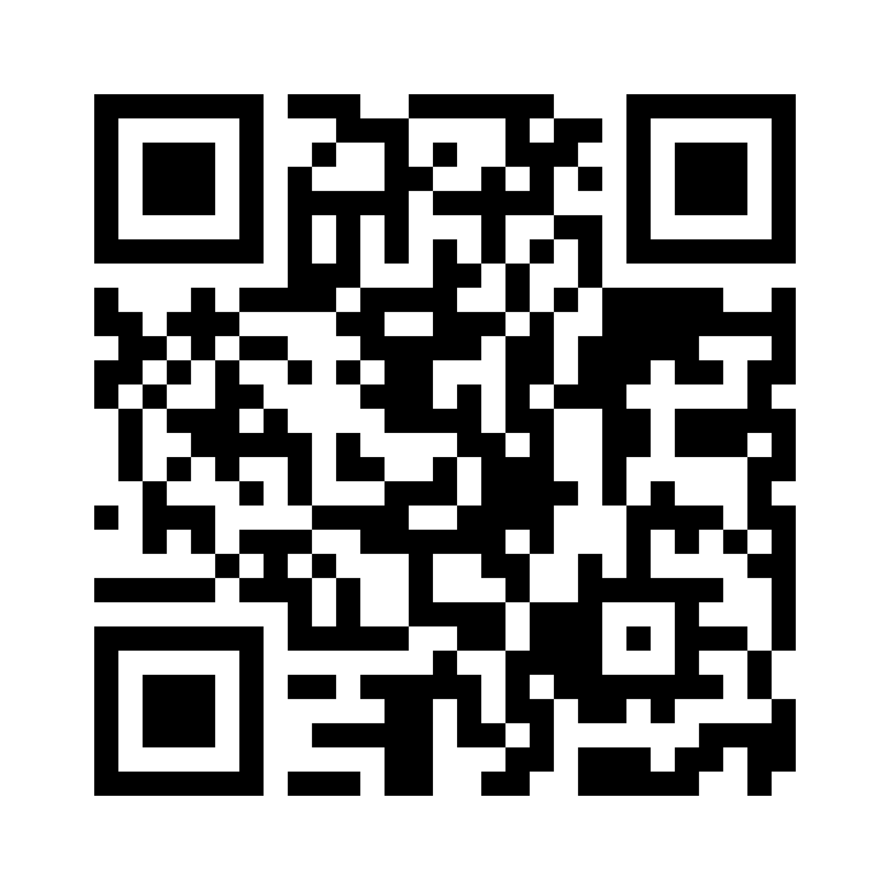

Thank you for your attention.
Point your cell phone camera at the QR code and access the PPSA website
ppsa.gov.br/eng
/presalpetroleoppsa
Samir Passos Awad
/presalpetroleo
Finance, Admin & Marketing Director
/pre-sal-petroleo-ppsa
samir.awad@ppsa.gov.br

